Slide 1
Intro to Cybersecurity
Friday @ 5:30PM in 2A14, Swearingen

Slide 2
Who are we?
The USC Cybersecurity Club is an student run organization dedicated to teaching students the principles of cybersecurity through presentations, hands-on practices, conferences, and competitions.

Slide 3



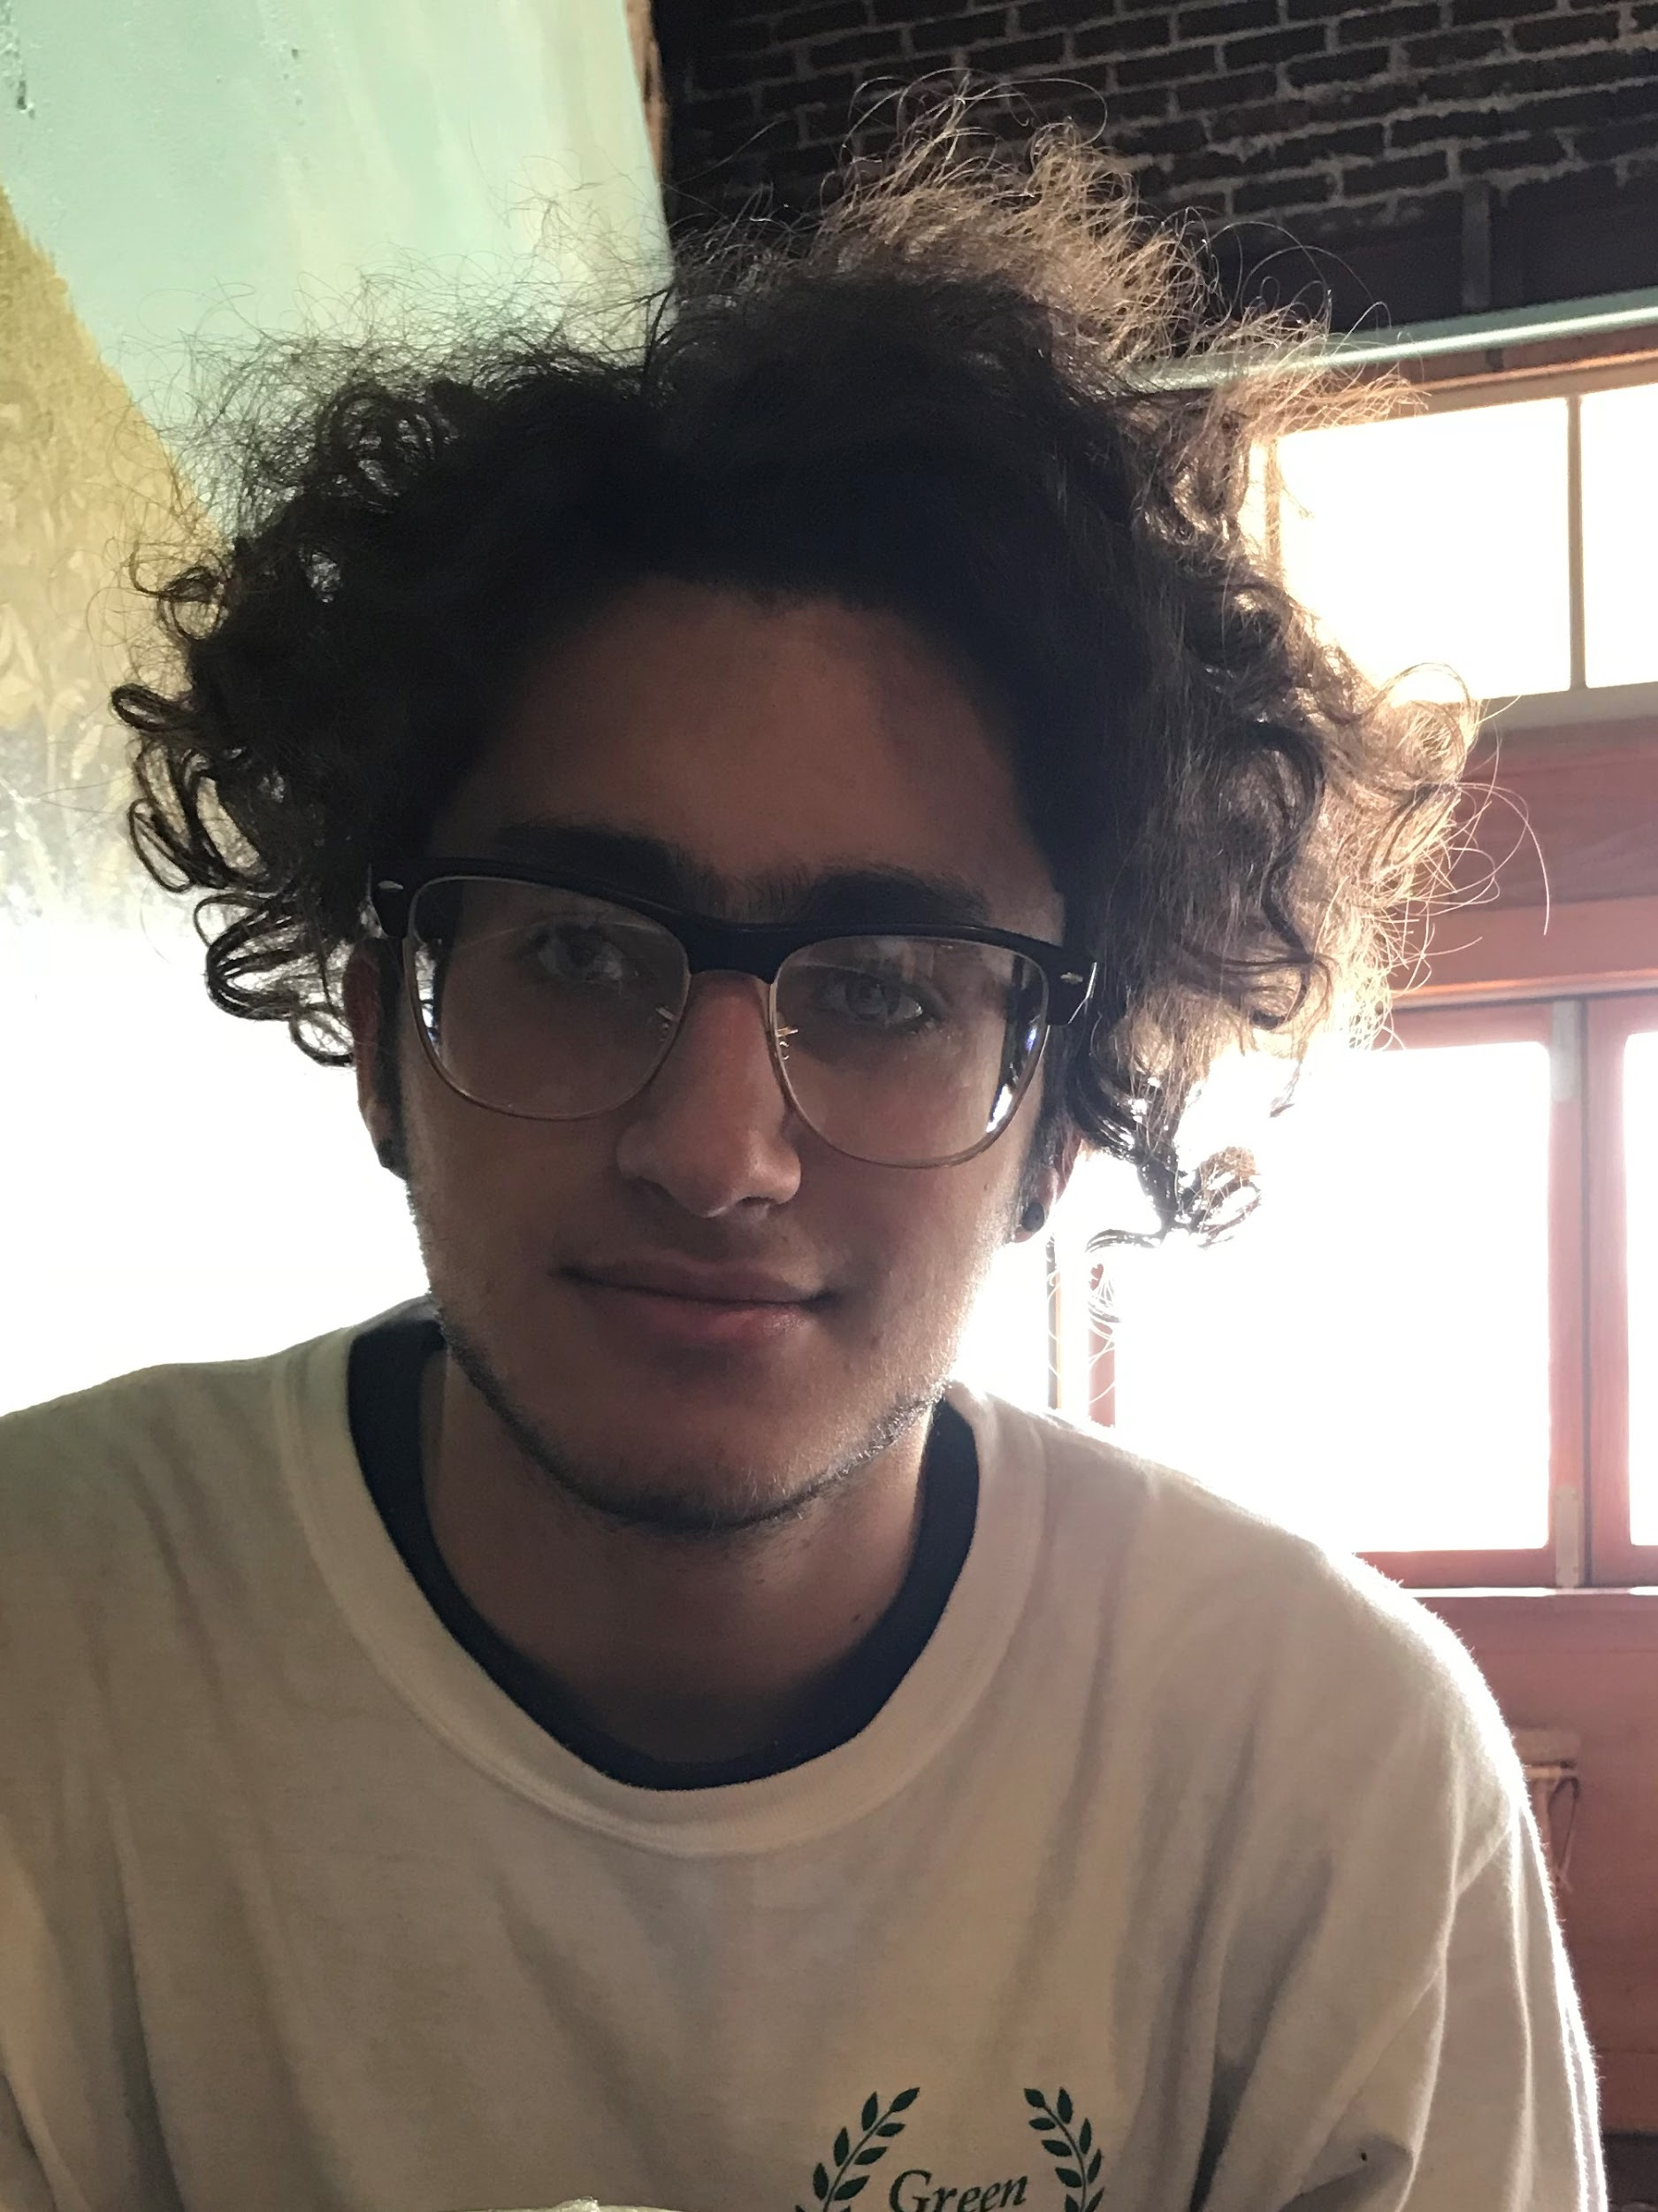


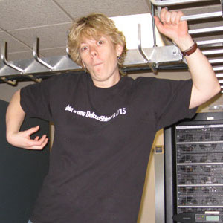

Officers
Clay Norris
President
Andy Michels
Vice President
William Edwards
Secretary
Luis Baez
Treasurer
Joshua Nelson
CTO
Noemi Glaesser Webmaster
James Coman
James Coman
Ronni Wilkinson
Mentor
Marshall Hollis
Mentor

Slide 4
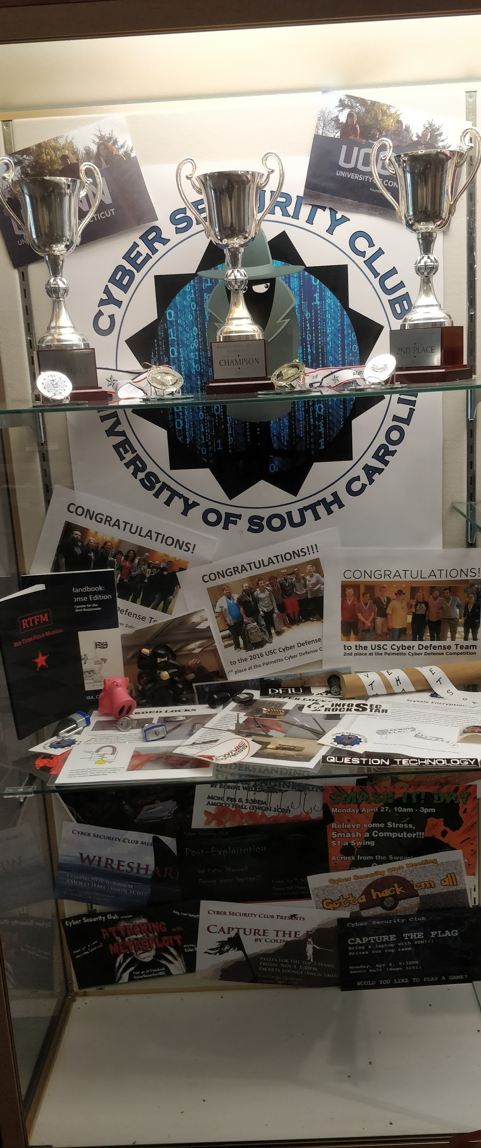
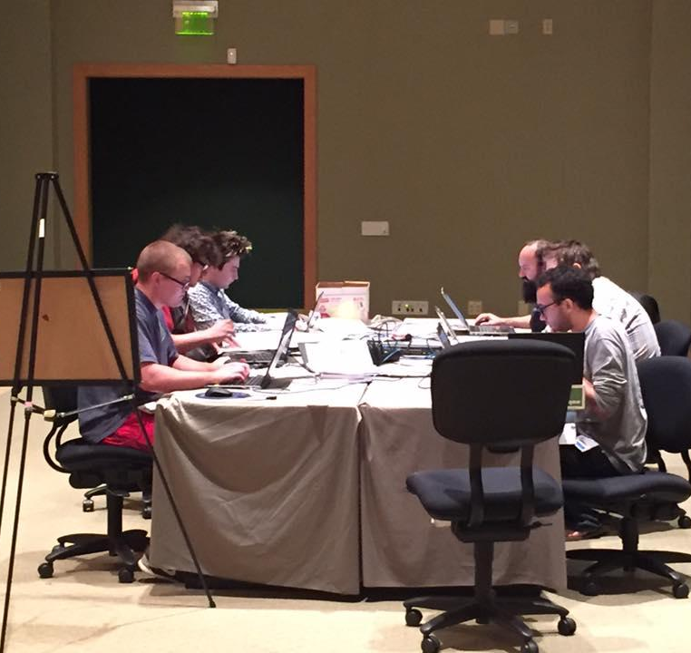
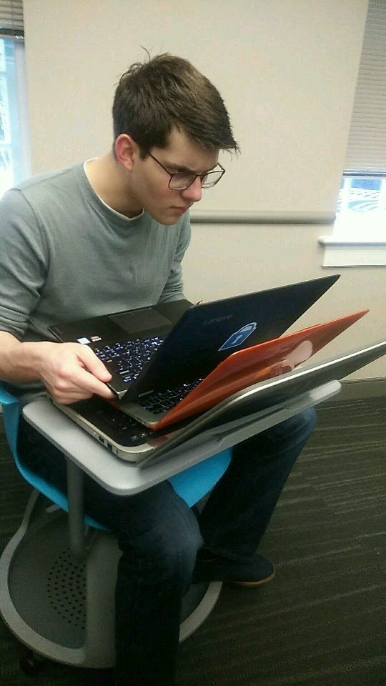
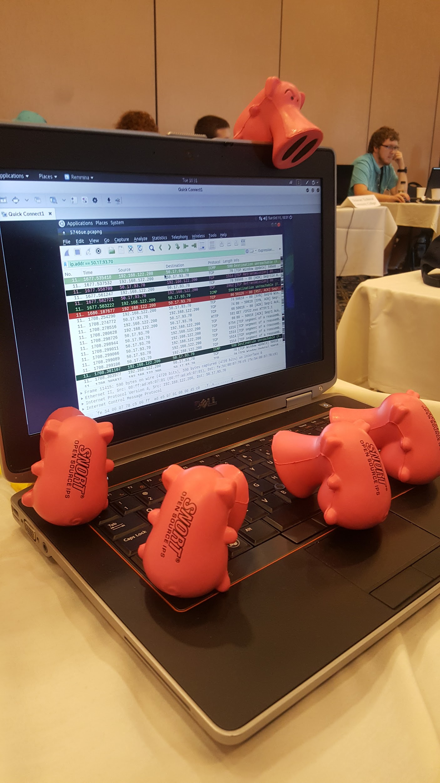
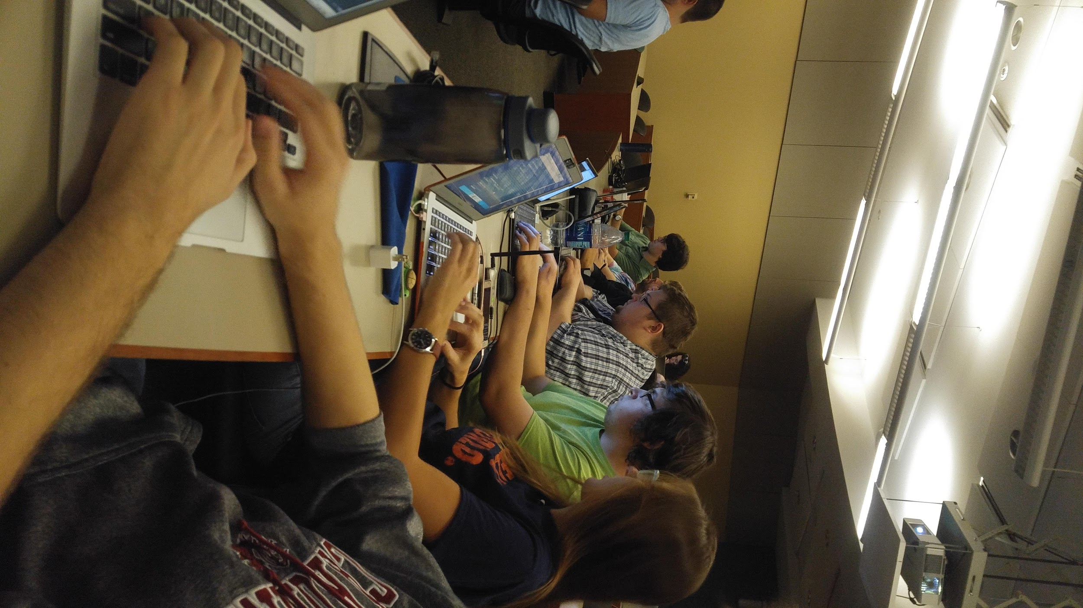
What do we do?

Slide 5
What can you learn?
Cryptography
Web App Hacking
Digital Reconnaissance
Network Defense
Reverse Engineering
Configuring Services (AD, DNS, FTP, Etc.)
Latest Cyber Security News
CTFs - Capture the Flag Competitions
CDCs - Cyber Defence Competitions
Many other topics

Slide 6
Some Previous Talks
Wireless Data Leakage: What your Wifi Signals Say About You - 4/13/18
Everything You Never Knew About SSH: Advanced SSH Functions - 4/6/18
Rise of the Bots: Building your own Botnet - 3/23/18
Intro to Crypto: Cryptography Basics - 10/11/17
Attacking with Metasploit: An Intro to the Metasploit Framework - 09/15/16
Gotta Hack ‘em All: Reverse Engineering Pokemon Go - 09/2/16
Stack Smashing: An Intro to Stack Overflows - 10/7/14

Slide 7
Fall Presentation Schedule
Week 1: Welcome to Cybersec!
Week 2: Computer Networking Crash Course
Week 3: Open Source Intelligence gathering and The Art of People Hacking
Week 4: Introduction to Penetration Testing
Week 5: Securing Web Applications
Week 6: Hacking through History: The Enigma Machine
Week 7: Introduction to Reverse Engineering
Week 8: Hacking through History: Stuxnet
Week 9: Introduction to Computer Networks Part 2: Packet Crafting with Scapy
Week 10: Lock Picking
Week 11: Hacking in Popular Culture

Slide 8
Fall Practice Schedule
Week 1: Linux Crash Course
Week 2: Windows Crash Course
Week 3: Computer Networking Pt 1.
Week 4: Computer Networking Pt2.
Week 5: Webapp Hacking Pt 1.
Week 6: Webapp Hacking Pt 2.
Week 7: Metasploit Framework
Week 8: Reverse Engineering Pt 1
Week 9: Reverse Engineering Pt 2.

Slide 9
How can you get Involved?
Facebook: Cybersecurity@USC
Twitter: @USCCyberSec
GroupMe: https://app.groupme.com/join_group/16796421
Website: https://usccyber.org
Email: cyberusc@gmail.com
Meeting Times: Fridays @ 5:30PM in Swearingen 2A14
Practice Times: ???

Slide 10
What is Cybersecurity
Cyber security is the practice of defending computers and servers, mobile devices, electronic systems, networks and data from malicious attacks. It is also known as information technology security or electronic information security. The term is broad-ranging and applies to everything from computer security to disaster recovery and end-user education.
TL;DR; Cybersecurity is a how-to on how to hack and how to avoid getting hacked

Slide 11
Why is it important?

Slide 12

A Timely Reference: It takes a Thief
Notes:
Show released on Discovery Channel in 2005 (joke about how Discovery channel is shit now)
Two co-stars, Matt Johnston and Jon Douglas Rainey, former professional thieves, break into people’s homes (with their permission) to show them how incredibly insecure their living conditions are
In Season 1, the thieves watch with the homeowners live on CCTV as Jon Rainey ramsacks their house. The following day, Matt Johnston would help them with a security redo of their house
In Season 2, arguably a much better season, the homeowners meet with the two hosts. They agree with them that their house may be burglarized at any given point in the next few weeks. Once the burgary happens, the two-hosts get in contact with the family and they review the footage. They then go over how they can work on improving their security
The point isn’t to just scare the shit out of the families, but to teach them in all the ways that they are insecure
In the same light, Cybersecurity focuses on two ends of the spectrum, offense and defense.

Slide 13
TL;DR
You have to understand how your systems are vulnerable before you can truly defend them.
Have to “think like a criminal” to understand how you might be attacked
Most dangerous vector always human
If you, your staff, or your organization fail to follow security policies in day-to-day interactions, you are leaving yourself vulnerable
Social Engineering one of the simplest and most dangerous attacks on security
Over the next school year, we will strive to give you all a rudimentary understanding of cybersecurity and the various topics it involves

Slide 14
Questions?

